Slide 1
Project Vulpix
Week 3 Report

Slide 2
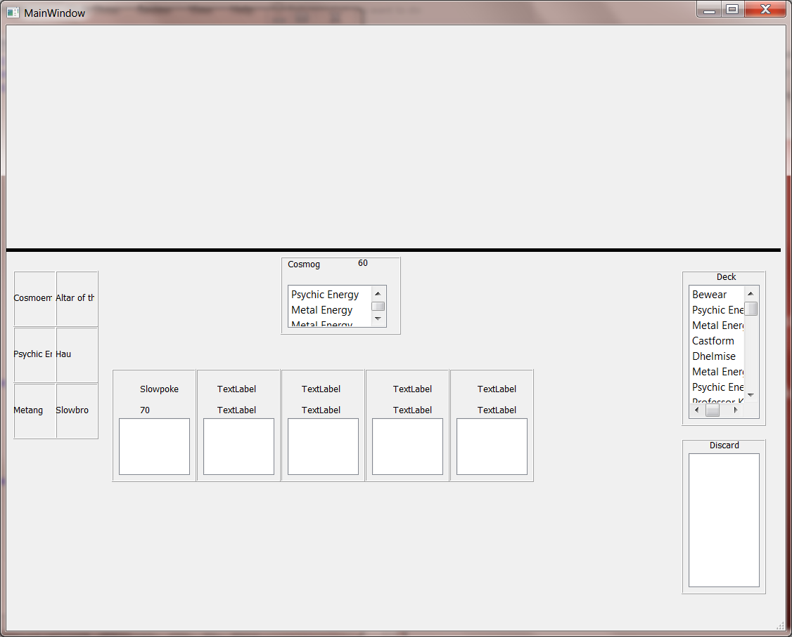
Debug GUI

Slide 3

Turns
Draw a card
Play Trainers
Play Pokemon
Play Energy
Use Abilities
Retreat
Attack

Slide 4
Attachments
Play Energy
Play Tools

Slide 5
Play Energy
Move Energy type cards from hand to Pokemon (Bench or Active)
Used to Attack or Retreat
Only allowed once per turn

Slide 6
Play Tools
Move Tool cards from hand to Pokemon (Bench or Active)
Used to enhance Pokemon

Slide 7

Retreat
Retreating is moving a Pokemon from the Active spot to the Bench
Requires energy to do
In code, we check for the retreat cost then compare it to the amount of energy attached.

Slide 8
Next Week
Figure out and implement attacking
Implement effects
Check for win conditions

